Slide 1
UML dynamic Modeling (Behavior Diagram)
Objects are created and destroyed, objects send messages to one another in an orderly fashion, and in some system, external events trigger operations on certain objects.
Objects have states.
The state of an object would be difficult to capture in a static model.

Slide 2
UML dynamic Modeling (Behavior Diagram)
In OOD dynamic modeling can be represented by following diagrams
Behavior Diagram / Interaction diagram
Sequence diagrams
Collaboration diagrams
Statechart Diagram
Activity Diagram

Slide 3
UML Interaction Diagram
It is a diagram that describes how groups of objects collaborate to get the job done.
Interaction diagram capture the behavior of a single use case, showing the pattern of interaction among objects.
The diagram shows a number of example objects and the messages passed between those objects within the use case.

Slide 4
UML Interaction Diagram
There are two kinds of interaction models: sequence diagrams and collaboration diagrams.

Slide 5
UML Interaction Diagram a) UML Sequence Diagram
The behavior of a system by viewing the interaction between the system and its environment.
A sequence diagram shows an interaction arranged in a time sequence( time oriented visualization).
It shows the objects participating in the interaction by their life lines and the messages they exchange, arranged in a time sequence.
A sequence diagram has two dimensions: the vertical dimension represents time, the horizontal represents different objects.

Slide 6
Sequence diagram notations
Objects
Lifeline
Actor
Activation box
Messages [ call message, return message, synchronous message, asynchronous message, self message , create message, destroy message ]
Iteration and condition
Note

Slide 7

Sequence Diagram Notations
1) Object Symbol
Represents a class or object in UML. The object symbol demonstrates how an object will behave in the context of the system. Class attributes should not be listed in this shape.

Slide 8

Sequence Diagram Notations
2) Lifeline
A lifeline represents an individual participant in the Interaction.

Slide 9
Sequence Diagram Notations
3) Actor
Represent roles played by human users, external hardware, or other subjects.

Slide 10
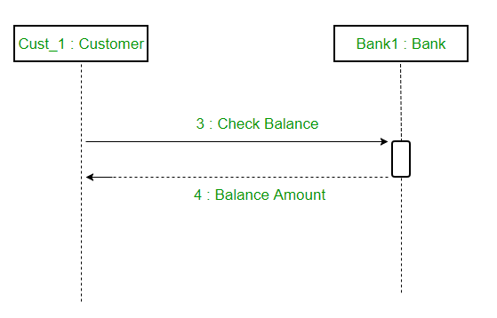
Difference between a lifeline and an actor
A lifeline always portrays an object internal to the system whereas actors are used to depict objects external to the system. The following is an example of a sequence diagram:

Slide 11

Sequence Diagram Notations
4)Activation Box
Represents the time needed for an object to complete a task. The longer the task will take, the longer the activation box becomes.

Slide 12
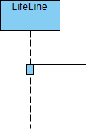
Sequence Diagram Notations
An activation is represented by a thin rectangle on a lifeline represents the period during which an element is performing an operation. The top and the bottom of the of the rectangle are aligned with the initiation and the completion time respectively

Slide 13
Sequence Diagram Notations
5) Messages
Communication between objects is depicted using messages.
The messages appear in a sequential order on the lifeline. We represent messages using arrows.
Lifelines and messages form the core of a sequence diagram.

Slide 14

Sequence Diagram Notations
5) Categories of Messages
a) Call Message
A call message defines a particular communication between lifelines of an interaction, which represents an invocation of operation of target lifeline.

Slide 15

Sequence Diagram Notations
5) Categories of Messages
b) Return Message
A return message defines a particular communication between lifelines of an interaction, which represents the pass of information back to the caller of a corresponded former message.

Slide 16
Sequence Diagram Notations
Synchronous messages
Asynchronous Messages

Slide 17
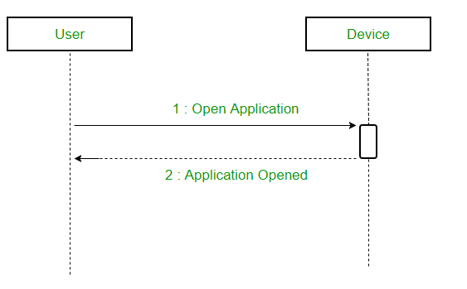
Sequence Diagram Notations
c) Synchronous messages
A synchronous message waits for a reply before the interaction can move forward.
The caller continues only when it knows that the receiver has processed the previous message i.e. it receives a reply message.

Slide 18
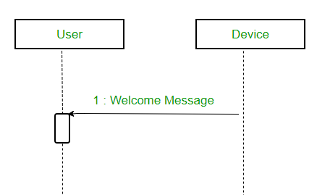
Sequence Diagram Notations
d) ASynchronous messages
An asynchronous message does not wait for a reply from the receiver.
The interaction moves forward irrespective of the receiver processing the previous message or not.
We use a lined arrow head to represent an asynchronous message.

Slide 19

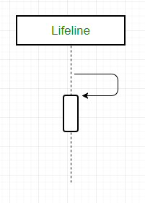
Sequence Diagram Notations
5) Categories of Messages
e) Self Message
Certain scenarios might arise where the object needs to send a message to itself.
Such messages are called Self Messages and are represented with a U shaped arrow.

Slide 20
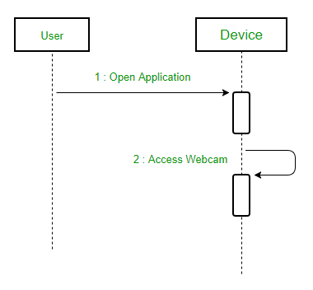
Sequence Diagram Notations
e) Self Message
For example – Consider a scenario where the device wants to access its webcam. Such a scenario is represented using a self message.

Slide 21
Sequence Diagram Notations
5) Categories of Messages
f) Create Message
We use a Create message to instantiate a new object in the sequence diagram.
There are situations when a particular message call requires the creation of an object.
It is represented with a dotted arrow and create word labelled on it to specify that it is the create Message symbol.

Slide 22
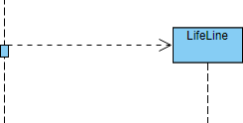
Sequence Diagram Notations
f) Create Message Representation
A create message defines a particular communication between lifelines of an interaction, which represents the instantiation of (target) lifeline.

Slide 23
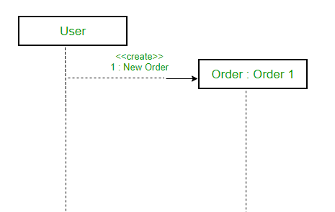
Sequence Diagram Notations
f) Create Message example
For example – The creation of a new order on a e-commerce website would require a new object of Order class to be created.
Figure – a situation where create message is used

Slide 24
Sequence Diagram Notations
5) Categories of Messages
g) Destroy/ Delete Message
We use a Delete Message to delete an object. When an object is deallocated memory or is destroyed within the system we use the Delete Message symbol.
It destroys the occurrence of the object in the system.
It is represented by an arrow terminating with a x.

Slide 25
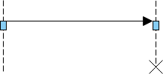
Sequence Diagram Notations
g) Destroy/ Delete Message Representation
A destroy message defines a particular communication between lifelines of an interaction, which represents the request of destroying the lifecycle of target lifeline.

Slide 26
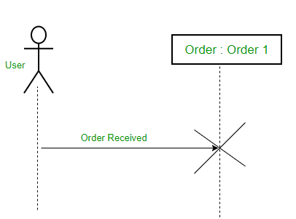
Sequence Diagram Notations
g) Destroy/ Delete Message example
For example – In the scenario below when the order is received by the user, the object of order class can be destroyed.
Figure – a scenario where delete message is used

Slide 27
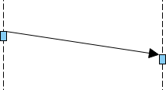
Sequence Diagram Notations
5) Categories of Messages
h) Duration Message
A duration message defines a particular communication between lifelines of an interaction, which shows the distance between two time instants for a message invocation.

Slide 28
Sequence diagram
6) Iteration and condition
frame: box around part of diagram to indicate if or loop
eg. Adding multiple items to the cart list [ loops ]
, free delivery on amt>X [ condition ]

Slide 29

Sequence Diagram Notations
7) Note
A note (comment) gives the ability to attach various remarks to elements. A comment carries no semantic force, but may contain information that is useful to a modeler.

Slide 30
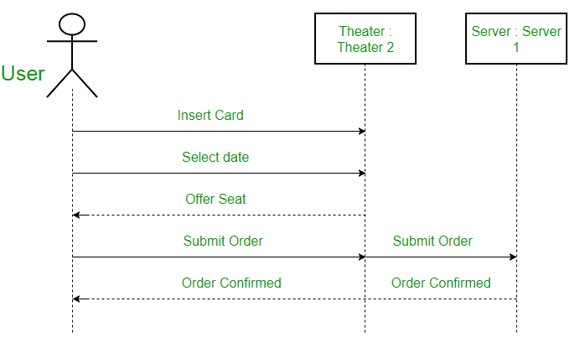
Sequence Diagram Example-1
Figure – an actor interacting with a seat reservation system

Slide 31
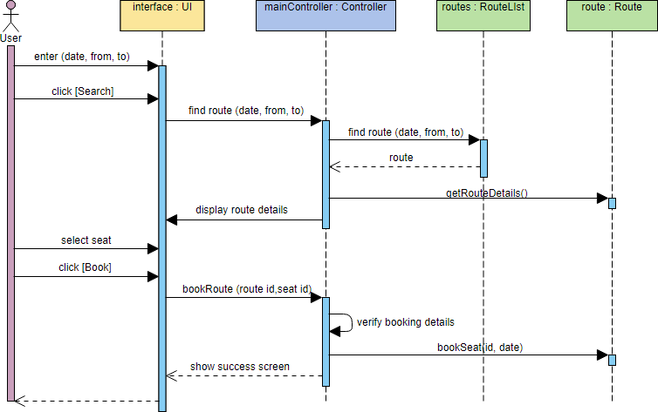
Sequence Diagram Example-2
The sequence diagram example below shows the interactions between a user and a ticket booking system in booking a seat. It consists of mainly four parts: The actor, which is the user, the boundary object ‘interface', the controller object ‘mainController' and two entity objects routes and route.

Slide 32
Example 1: Withdraw saving
Scenario:
He enters his card into an ATM (automated teller machine).
The ATM machine prompts “ Enter PIN”.
The customer enters his PIN.
The ATM (internally) retrieves the bank account number from the card.
The ATM encrypts the PIN and the account number and sends it over to the bank.
The bank verifies the encrypted account and PIN number.
If the PIN number is correct, the ATM displays, “Enter Amount”.
Draws money from the bank account and pays out the amount.

Slide 33
Withdraw saving
Use Case: Withdraw Saving
Actors: Bank, Client
Flow of Events:
Bank client insert ATM card into ATM machine
ATM machine request PIN code
Bank client enter PIN code
Verify PIN code entered with saving account
ATM machine request amount if the PIN is valid
Bank client enter the required amount
Process the transaction in the client account
ATM machine dispense cash
ATM machine print receipt when the transaction completed
Alternative Flow of Events
Invalid PIN code entered. Indicate error message. Return step 3.

Slide 34
Identifying Classes
Bank Client
ATM Card
ATM Machine
Savings Account
Cash
Message

Slide 35
Client
ATM-Machine
SavingAccount
Insert ATM card
Request PIN
Enter PIN code
Verify PIN code
PIN valid
Request amount
Enter amount
Process transaction
Transaction successful
Dispense cash
Print receipt

Slide 36
Example 2: Logging in
Let's start with the simple example above: a user logging onto the system. The Logon use case can be specified by the following step:
1. Logon dialog is shown
2. User enters user name and password
3. User clicks on OK or presses the enter key
4. The user name and password are checked and approved
5. The user is allowed into the system
Alternative: Logon Failed - if at step 4 the user name and password are not approved, allow the user to try again

Slide 37
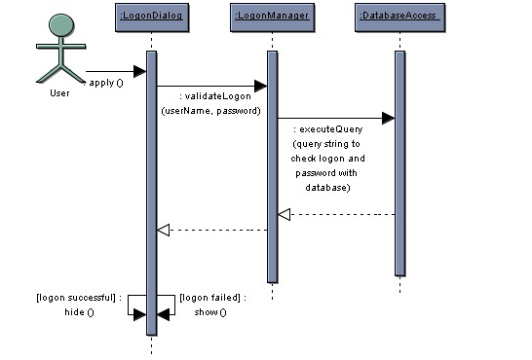

Slide 38
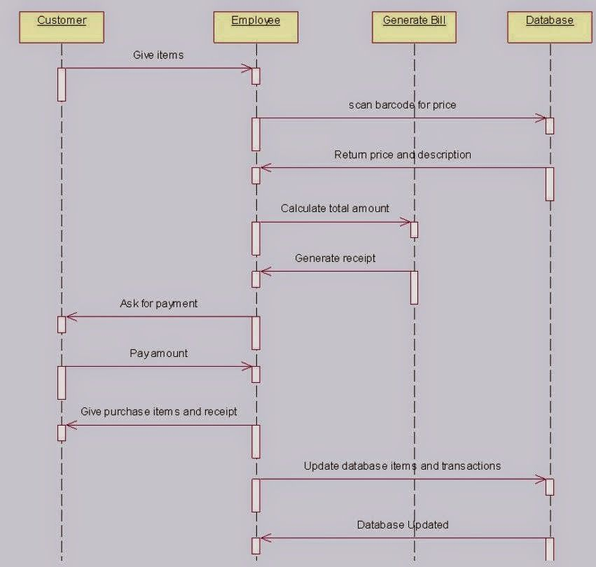
Example : Supermarket billing

Slide 39
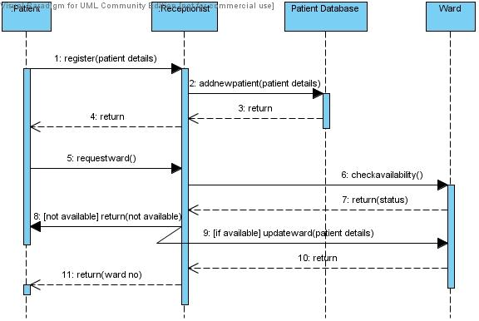
Sequence Diagram for Patient Admit / Registration

Slide 40
UML Interaction Diagrams b) UML Collaboration Diagram
known as Communication Diagram in UML 2.x
used to show how objects interact to perform the behavior of a particular use case, or a part of a use case.
Along with sequence diagrams, collaboration are used by designers to define and clarify the roles of the objects that perform a particular flow of events of a use case.
They are the primary source of information used to determining class responsibilities and interfaces.

Slide 41
Why Collaboration Diagram?
Unlike a sequence diagram, a collaboration diagram shows the relationships among the objects.
Sequence diagrams and collaboration diagrams express similar information, but show it in different ways.
The sequence diagram is used when time sequenceis main focus.

Slide 42
UML Collaboration Diagram
A collaboration diagram represents a collaboration, which is a set of objects related in a particular context, and interaction, which is a set of messages exchanged among the objects within the collaboration to achieve a desired outcome.
In a collaboration the sequence is indicated by numbering the messages.
The collaboration is more compressed, other things can be shown more easily.
It provides several number scheme.

Slide 43
Notations of Collaboration Diagram
1) Objects
An object is represented by an object symbol showing the name of the object and its class underlined, separated by a colon:
Object_name : class_name

Slide 44
Notations of Collaboration Diagram
You can use objects in collaboration diagrams in the following ways:
Each object in the collaboration is named and has its class specified
Not all classes need to appear
There may be more than one object of a class
An object’s class can be unspecified. Normally you create a collaboration diagram with objects first and specify their classes later.
The objects can be unnamed, but you should name them if you want to discriminate different objects of the same class.

Slide 45
Notations of Collaboration Diagram
2) Actors
Normally an actor instance occurs in the collaboration diagram, as the invoker of the interaction.
If you have several actor instances in the same diagram, try keeping them in the periphery of the diagram.
Each Actor is named and has a role
One actor will be the initiator of the use case

Slide 46
Notations of Collaboration Diagram
3) Links
Links connect objects and actors and are instances of associations.

Slide 47
Notations of Collaboration Diagram
Links are defined as follows:
A link is a relationship among objects across which messages can be sent. In collaboration diagrams, a link is shown as a solid line between two objects.
An object interacts with, or navigates to, other objects through its links to these objects.
A link can be an instance of an association, or it can be anonymous, meaning that its association is unspecified.

Slide 48
Notations of Collaboration Diagram
4) Messages
A message is a communication between objects that conveys information with the expectation that activity will ensue.
In collaboration diagrams, a message is shown as a labeled arrow placed near a link.

Slide 49
Notations of Collaboration Diagram
Messages
The message is directed from sender to receiver
The receiver must understand the message
The association must be navigable in that direction

Slide 50
Steps for Creating Collaboration Diagrams
Identify behavior whose realization and implementation is specified
Identify the structural elements (class roles, objects, subsystems) necessary to carry out the functionality of the collaboration
Decide on the context of interaction: system, subsystem, use case and operation
Model structural relationships between those elements to produce a diagram showing the context of the interaction
Consider the alternative scenarios that may be required
Draw instance level collaboration diagrams, if required.
Optionally draw a specification level collaboration diagram to summarize the alternative scenarios in the instance level sequence diagrams

Slide 51
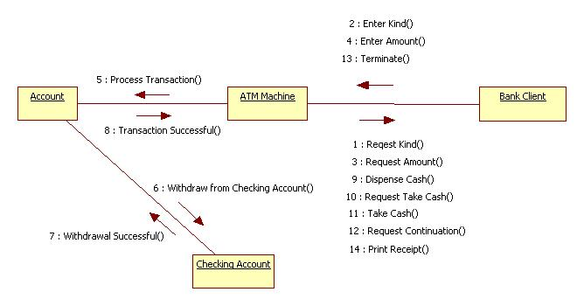
Colloaboration

Slide 52
How to choose between using a sequence or collaboration diagram
Sequence diagrams
Make explicit the time ordering of the interaction.
Use cases make time ordering explicit too
So sequence diagrams are a natural choice when you build an interaction model from a use case.
Make it easy to add details to messages.
Collaboration diagrams have less space for this

Slide 53
How to choose between using a sequence or collaboration diagram
Collaboration diagrams
Can be seen as a projection of the class diagram
Might be preferred when you are deriving an interaction diagram from a class diagram.
Are also useful for validating class diagrams.

